Slide 1
Meeting June, 2025
Changes of note:
MUT no longer requires Tecplot to generate IA, JA (ConnectionList) arrays
Bug fix: when triangular element had all three nodes on outer boundary
Simple saturated-flow case now runs but drawdown for the Theis pumping example is much less than predicted
In Visual Studio:
MUT Release version (mut.exe) has been tested it.
If compiled in debug mode, the MUT execuable is called mut_debug.exe.
Both exe’s are copied to the USERBIN directory.

Slide 2
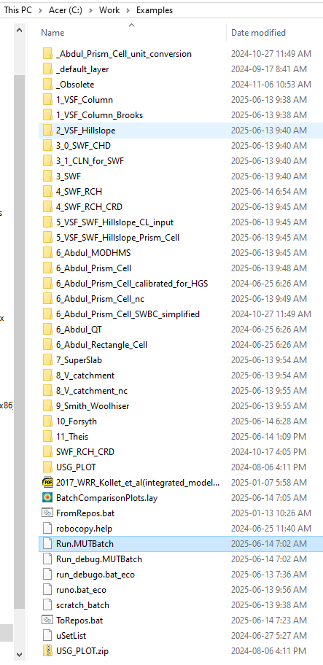
MUT_Batch
I now use this to run the verification problems with the Release mode version of MUT. The repository is here:
https://github.com/Grdbldr/MUT_Batch.git
It is similar to the old HSBatch code and reads an input file containing directory names. In my case, I have my verification problems in the directory and the input file is Run.MUTBatch.

Slide 3
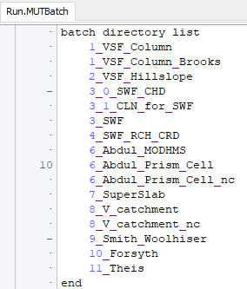
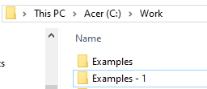
MUT_Batch is hardwired to use the instructions:
mut _build
USGS_1 modflow
mut _post
on each directory.
There is a Tecplot layout file BatchComparisonPlots.lay that is set up to plot Current and Previous results. It is hardwired to read the Tecplot output files from the Examples directory and compare these to results in a directory called “Examples – 1”.

Slide 4
